Slide 1
컴퓨팅 기초: 처음 만나는 컴퓨팅
기말 프로젝트
자유로운 지구생활

Slide 2
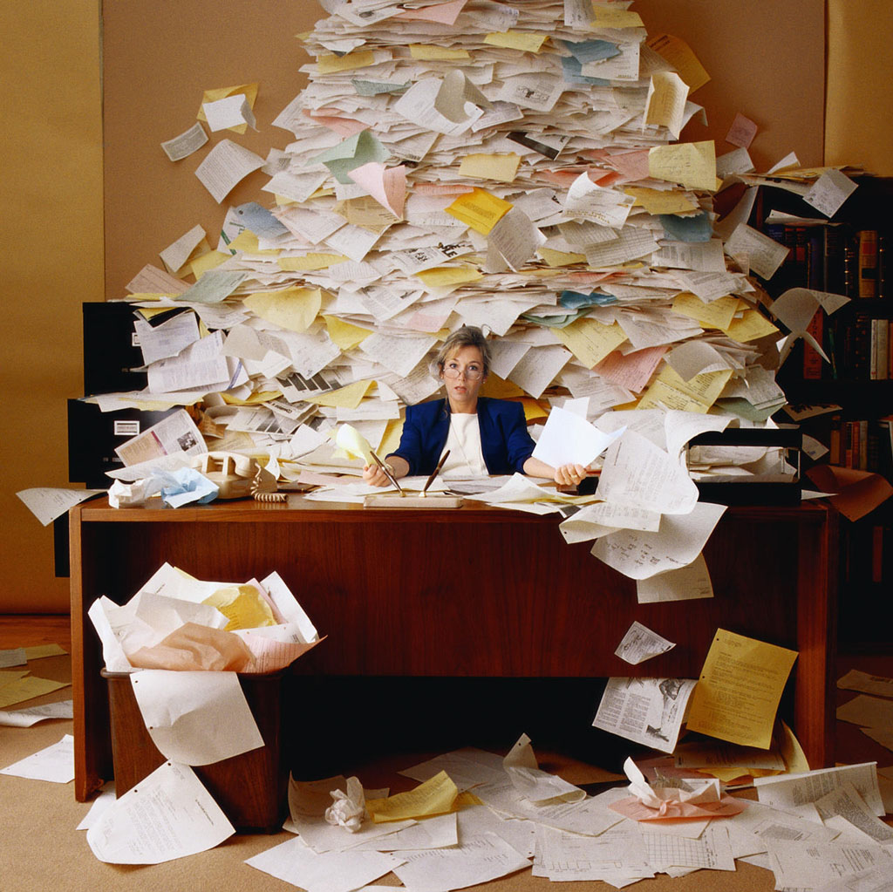
EXCUSE

Slide 3
TEAM
자유로운 + 지구생활
(자유전공학부 문동건) + (지구환경과학부 허정)

Slide 4
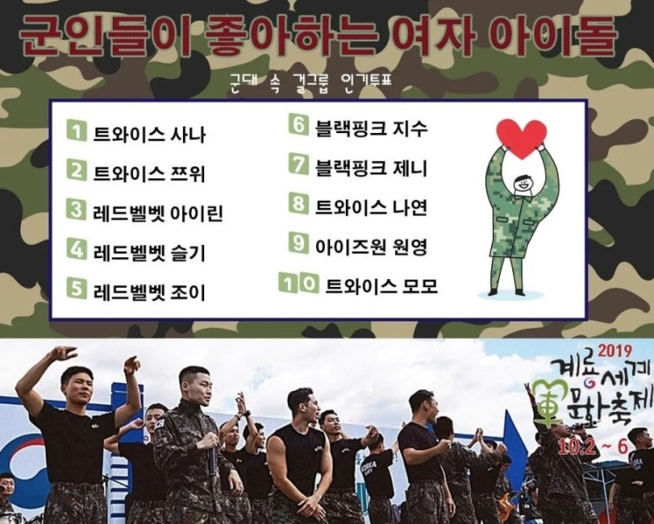
SUBJECT
1. Suggestion
When I was in army …

Slide 5
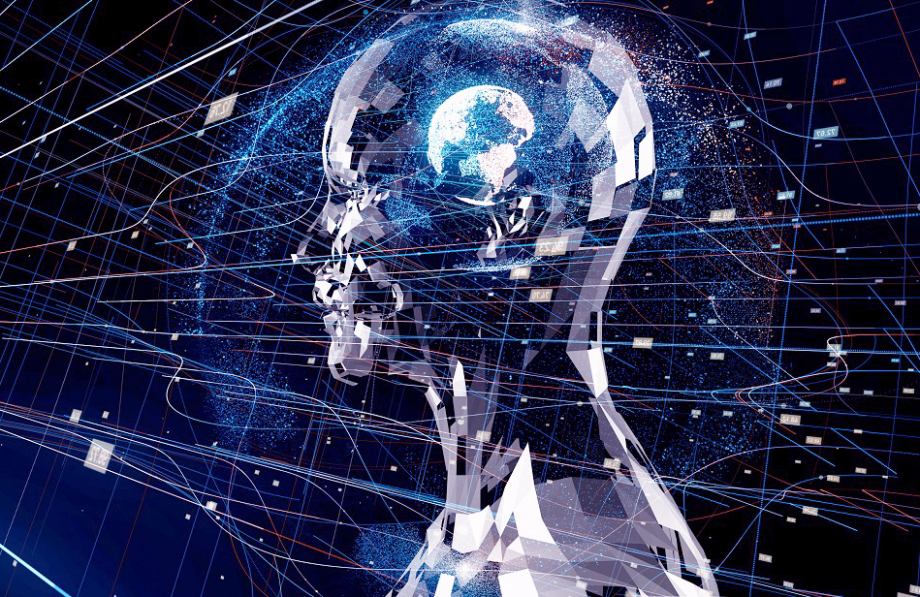
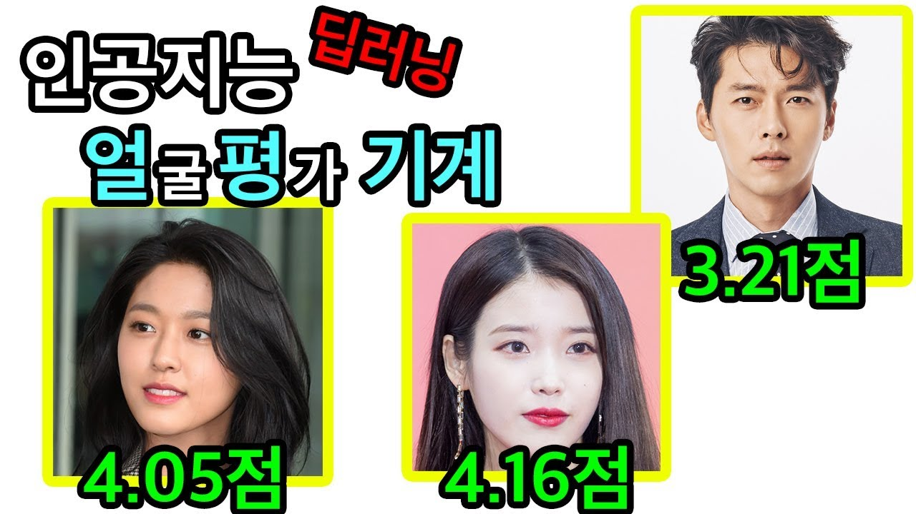
SUBJECT
2. Acceptance
Interested in AI

Slide 6
SUBJECT
3. Conclusion
Interactive web
that returns best image of searched name

Slide 7
PRODUCT
1. Interactive web
Let’s Go!
* 로컬 환경에서 Flask를 실행시킨 후 링크를 클릭해야 열립니다.

Slide 8
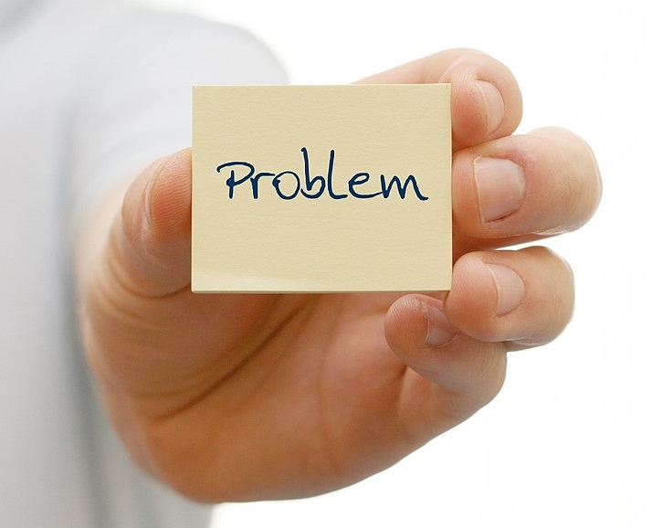

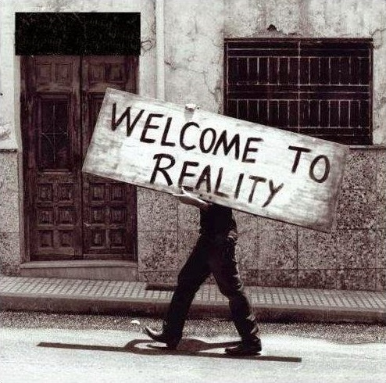
LESSONS LEARNED
1. Coding?
→
→

Slide 9
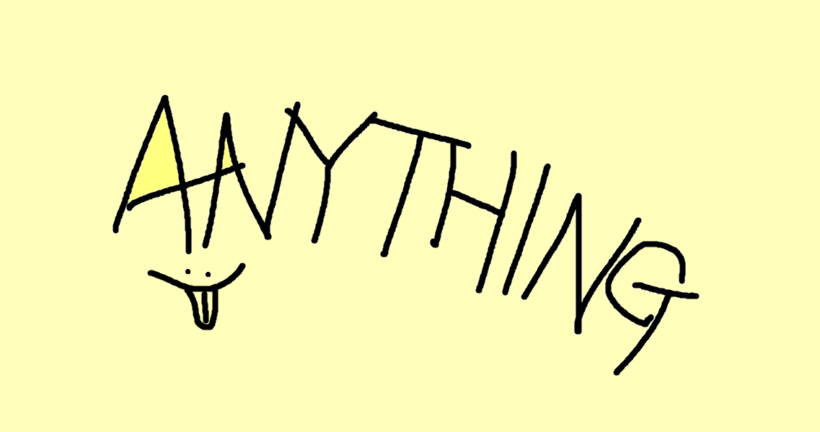
LESSONS LEARNED
2. Anything in the real world

Slide 10
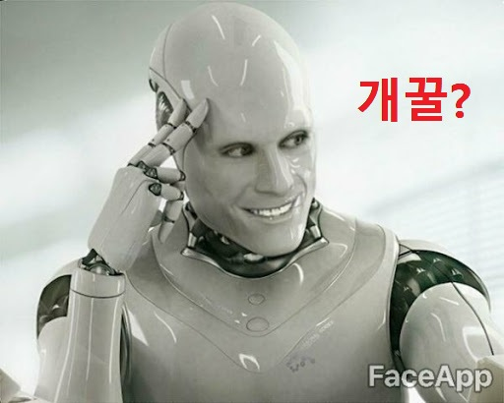
OUR STORY
1. Course review
3학점 S/U ?

Slide 11
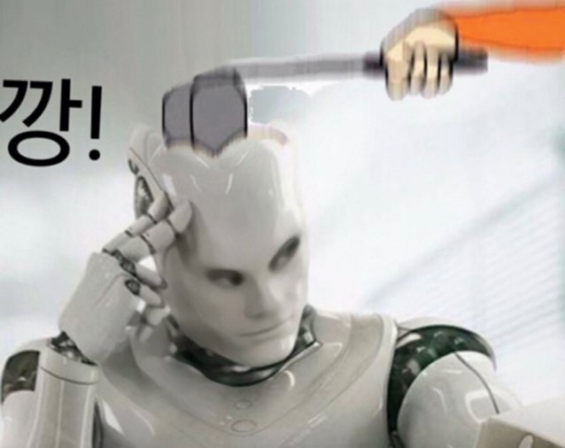
OUR STORY
1. Course review

Slide 12
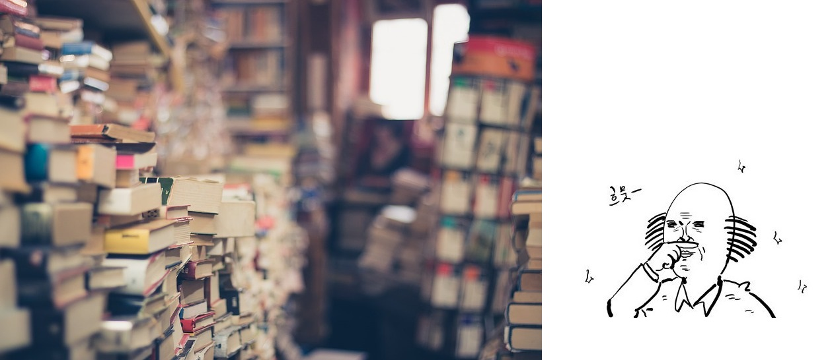
OUR STORY
1. Course review

Slide 13

OUR STORY
2. Dong-gun’s story

Slide 14

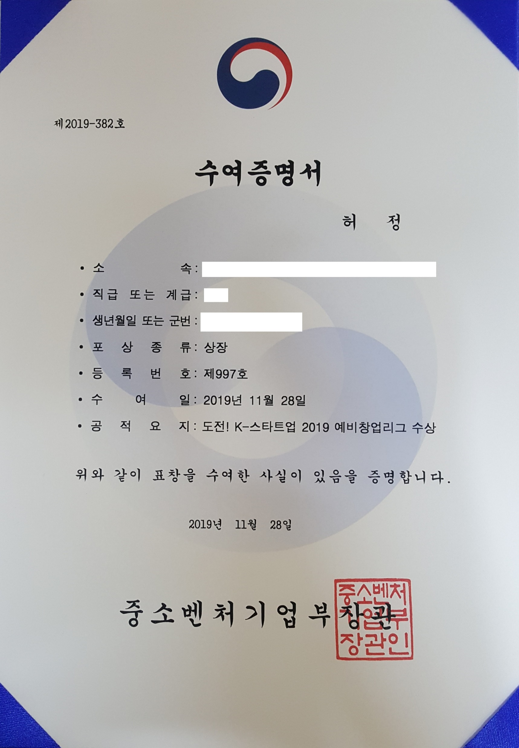
OUR STORY
3. Jeong’s story

Slide 15
THANK YOU!

